Slide 1



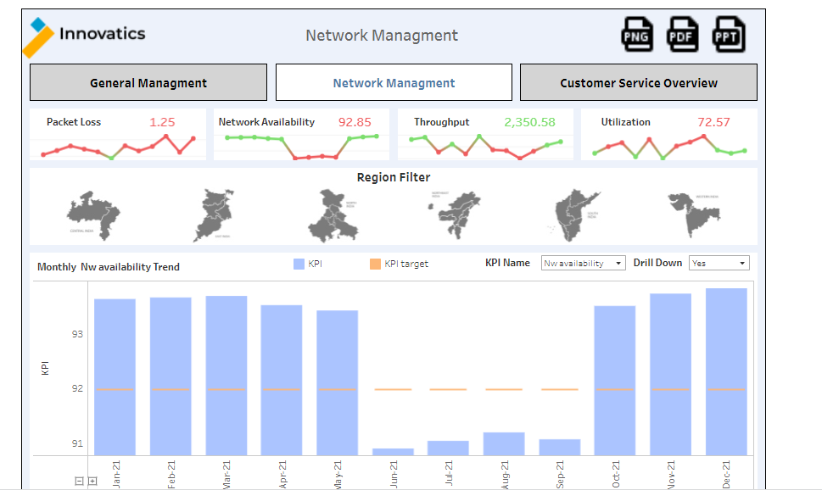
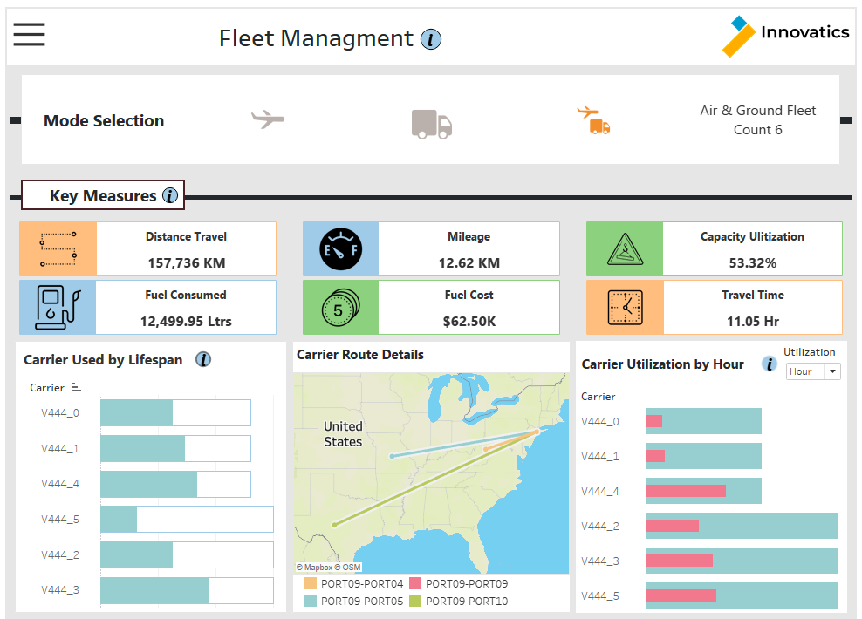
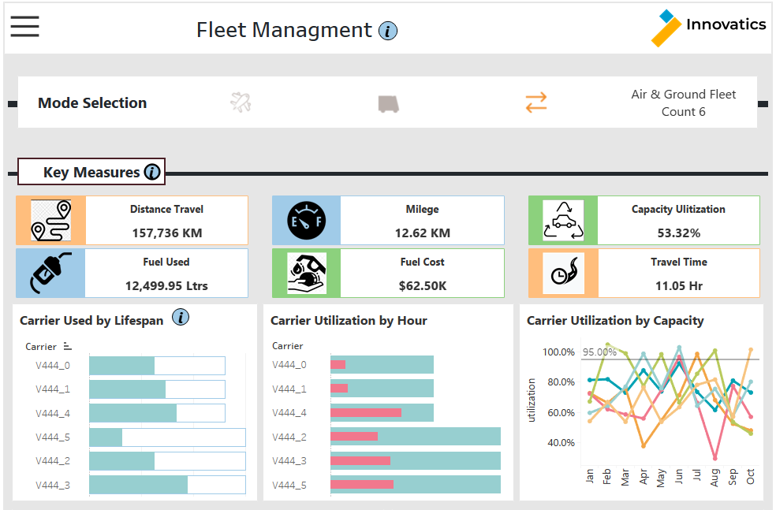
Fleet Management Dashboard
Motive
Analytics Pipeline
Major Challenges
Since Company want to reduce cost and increase profit which address over here using different 3 dashboards.
Our Solution
There are 3 Dashboard mainly to solve problem in 3 stages.
In Fleet Management all Fleet related KPI involve and track all Fleet KPI based on that we decide which fleet better for which route or service.
In Route Cost Summary each route wise cost/revenue and profit identify and track month level detail analysis which route we need to continue or divert.
In Warehouse cost summary each warehouse wise cost/revenue and profit check and based in that identify for which product we need to hold inventory or not and for loss making product at least at which price we cell product so not get lose in business
Marketing Tools and Platforms
Data Transformation
Business Intelligence Tools
Overall data taken for Fleet Management Dashboard from Fleet server on daily activity logs and then perform and check KPI data
Route level Data from route level portal and warehouse data from warehouse portal.
All received data will be stored and when require use from SQL and Excel work for further and some operation done on tableau prep as well.
Monthly,weekly and daily refresh plan for updated data.
Track Fleet KPI, Route Cost KPI and Warehouse KPI for cost reduction.
Dashboard Sample and Use Case
Dashboard
Benefits
Different KPI performance and tracking using dashboard Management can check Fleet performance monthly basis and decide perfect fleet with good capacity and mileage for reduction in cost.
Route cost summary Management can decide which route is more profitable where get higher order and profit margin so based on that which route need to continue or not identify
Warehouse cost summary can identify in which warehouse which inventory need to hold and for product which product not profit making so at which price we can sell
This dashboard shows a portion of what information can be viewed by Fleet Manager.
The use case shown here is for the performance of the Fleet with different mode and main KPI as well Capacity ,Travel distance,Fuel consumed all KPI measure on Monthly level for each Fleet .
Using Map for each fleet route can check and details for each fleet and Using scatter plot identify which Fleet suitable for long route travel based on capacity and mileage which help to reduce cost,
* Estimated

